Slide 1
Nervous System
Chapter 48/49
Bhavya Guduru

Slide 2
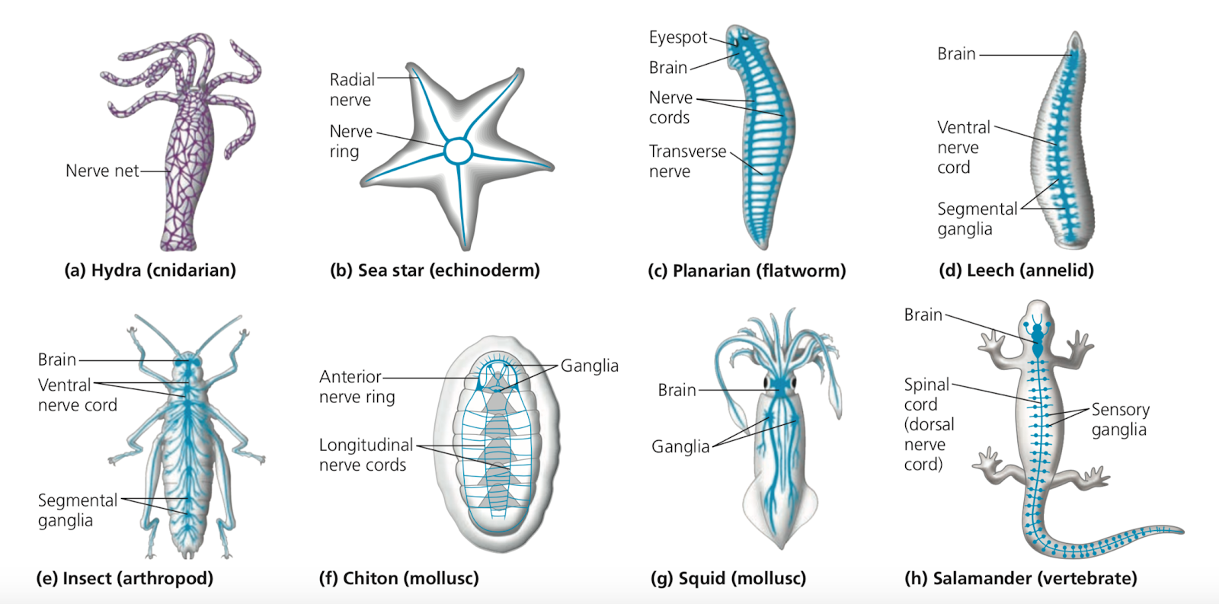
Types of Nervous Systems
Simple organisms utilize nerve nets
Neurons controlling contraction and expansion of gastrovascular cavity are arranged in nerve nets

Slide 3
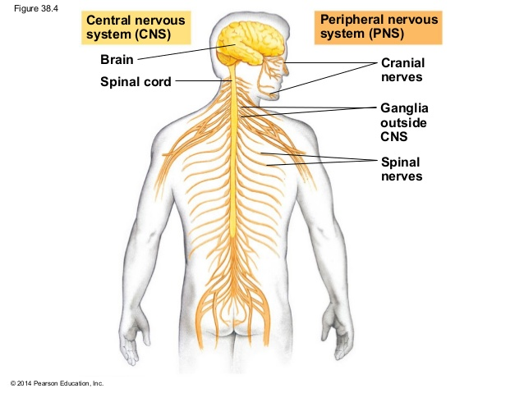
The Nervous System
Allows animals respond to sense and react to external stimuli
Made up of the Central Nervous System (CNS) and Peripheral Nervous System (PNS)
Central Nervous System
Brain and Spinal Cord
Sensory input, information processing, motor output*
Peripheral Nervous System
Nerves that connect CNS with rest of the body
Transmit information to and from the CNS and help regulate vertebrate’s movement

Slide 4
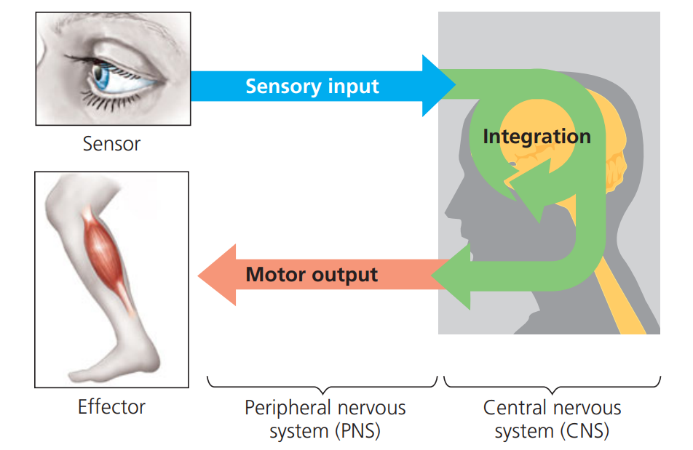
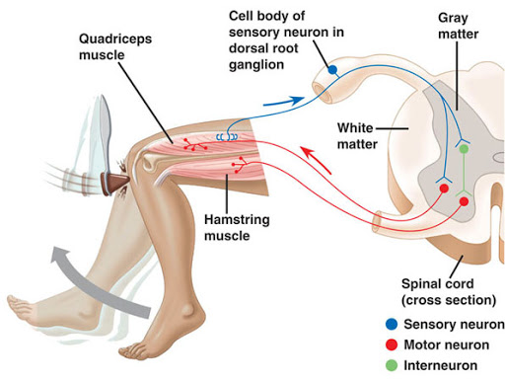
Information Processing
Sensory Neuron: transmit info from sensors that detect external stimuli (senses) and internal conditions
Interneurons: info sent here in the CNS to integrate the input
Motor Neurons: motor output leaves CNS via these and communicate with effector cells (muscle / endocrine cells)
Knee Jerk Reflex
Notes:
External stimuli ex: light sound touch heat smell
Internal Conditions ex: blood pressure blood co2 level muscle tension
Effector Cells (muscle or endocrine cells)

Slide 5
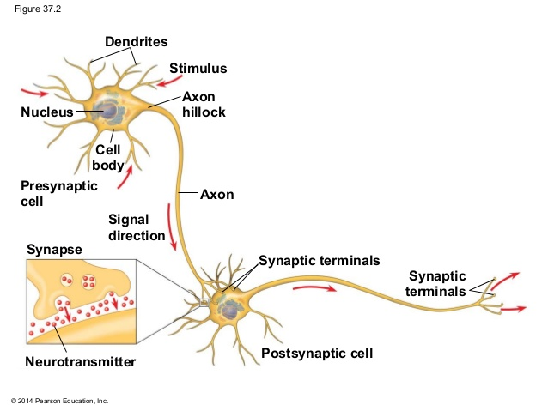
Structure of a Neuron
Dendrites: receive signals
Axons: transmit signals
Soma: Cell body; nucleus
Axon Hillock: axon joins the cell body
Presynaptic vs Postsynaptic
Neurotransmitters: chemical messengers
Myelin Sheath: enclose these axons; speed up action potentials

Slide 6
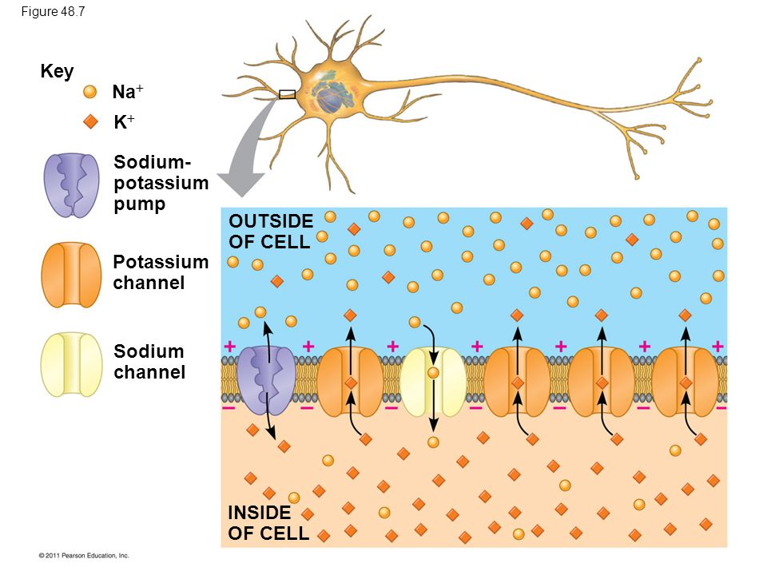
Membrane Potential
Membrane Potential: electrical difference (voltage) across plasma membrane
Resting membrane potential: between -60 and -80 mV; inside of cell is negative to outside
Sodium Potassium Pump: 3 Na+ in; 2 K+ out; maintain membrane potential; against gradient and needs ATP
Potassium Channel: K+ out; MOST ABUNDANT
Sodium Channel: Na+ in

Slide 7
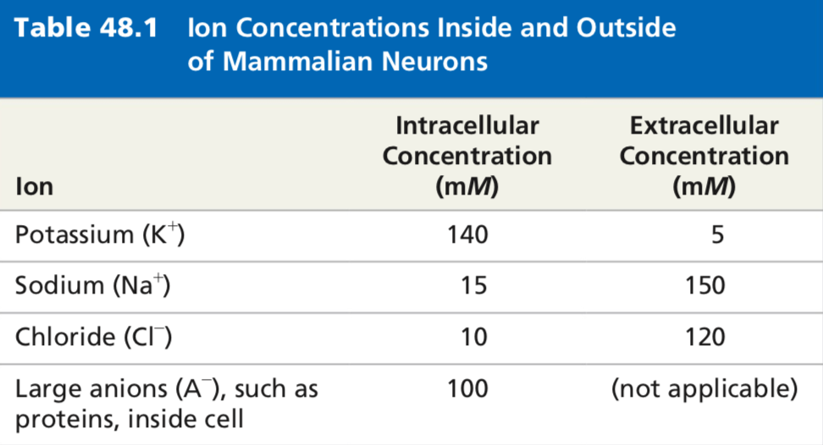
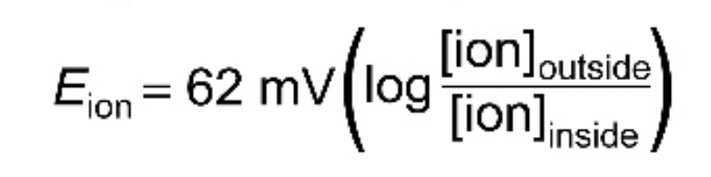
Equilibrium Potential
Equilibrium Potential: magnitude of voltage at equilibrium
Nernst Equation: applies to any membrane that is permeable to a single type of ion
K+ charge: -92 mV; is at equilibrium when inside of membrane is 92 mV more negative than outside
Na+ charge: +63 mV; at equilibrium when inside of membrane is 62 mV more positive than outside

Slide 8
Action Potential
Action Potential: electrical activity initiated by a depolarization current
Depolarization: voltage gated Na+ channels open due to a stimulus and rush of Na+ into channel; increases overall voltage to peak of AP (+40 mV)
Repolarization: Na+ channels inactivate and voltage K+ channels open and let K+ reduce membrane potential (after depolarization!)
Hyperpolarization: voltage goes past resting potential (keeps decreasing); occurs because of K+ channels
Refractory Period: when membrane is hyperpolarized and trying to reach resting potential; occurs due to Na+ channels trying to open and K+ trying to close; NOT due to ion gradient

Slide 9
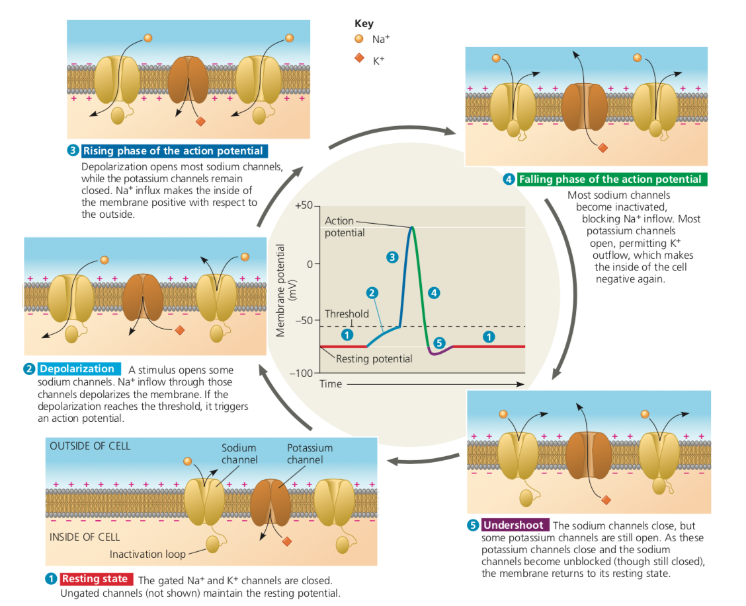
Notes:
Walkthrough diagram!

Slide 10
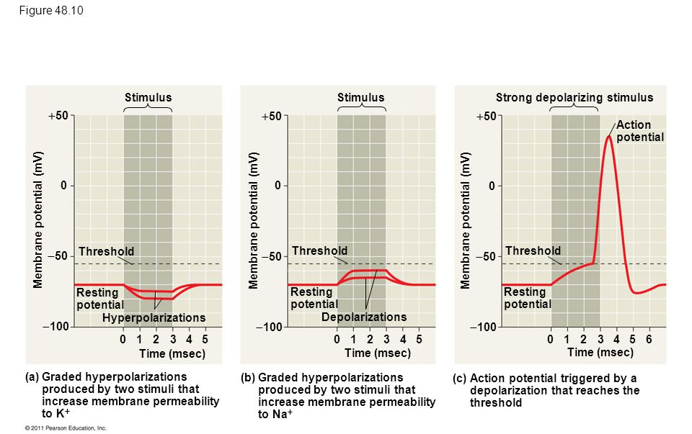
Action Potential
Hyperpolarization: below resting potential!
Depolarization: above resting potential!
Notes:
Walkthrough!

Slide 11
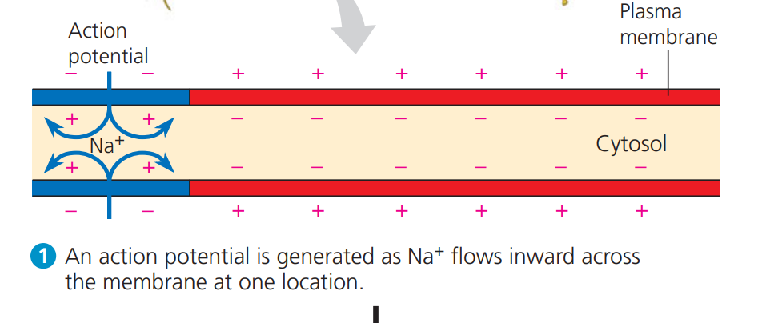
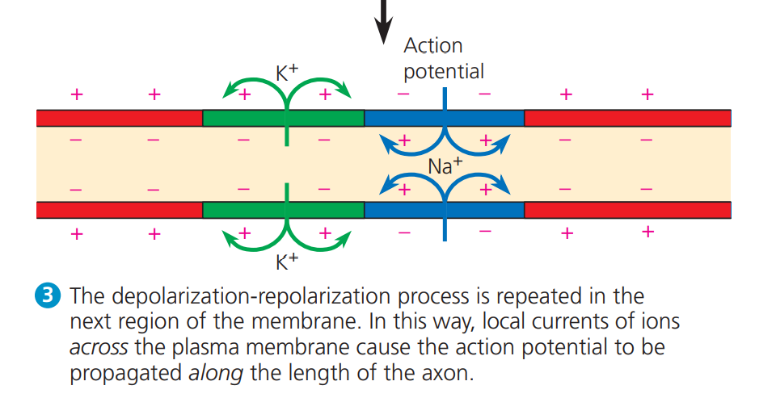
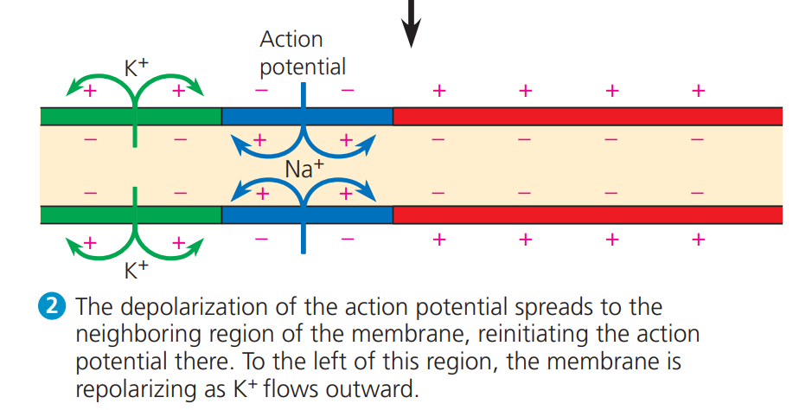
Conduction of Action Potentials
Action potentials need to travel long distances without diminishing

Slide 12
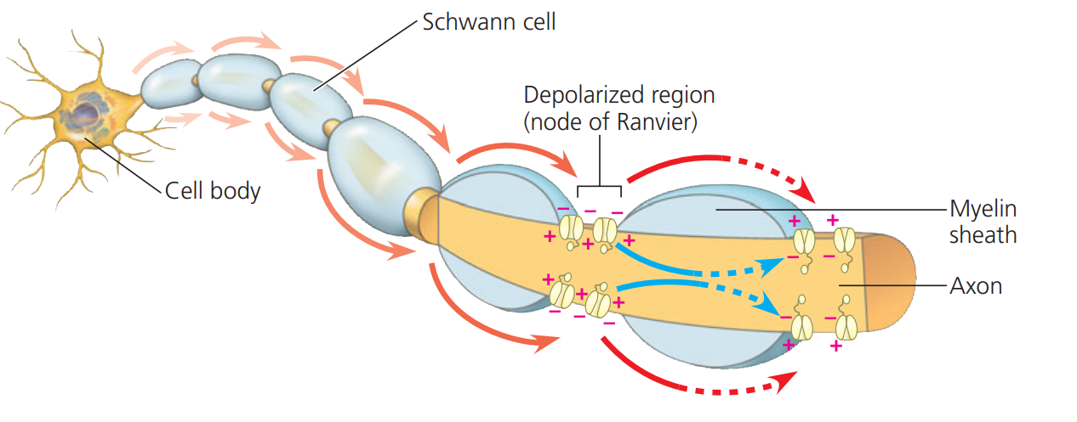
Transmission & Saltatory Conduction
Transmission Speed can be impacted by several factors:
Diameter: Wider the axon the faster the conduction; resistance inverse to area
Insulation: myelin insulates the axon membrane; causes depolarization to spread farther along axon
Saltatory Conduction: action potential appears to jump from node to node
Voltage gated Na+ and K+ channels are populated at gaps in myelin sheath called Nodes of Ranvier → inward current produced travels all the way to next node and depolarizes membrane to generate a new action potential

Slide 13
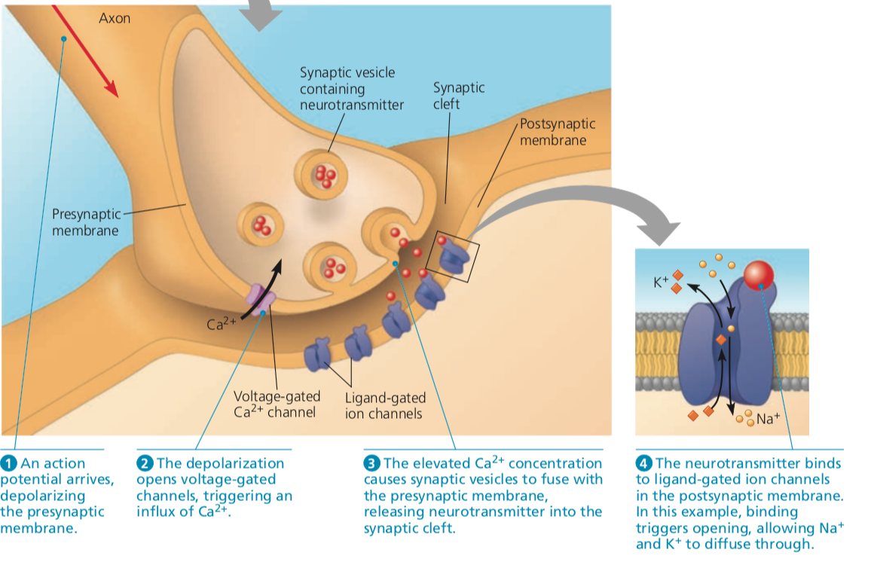
Synapses
Synapses: neurons communicate with other cells here
Electrical synapse: gap junctions to allow current travel from cell to cell
Chemical Synapse: involve release of chemical neurotransmitters in synaptic vesicles from pre to postsynaptic cell

Slide 14
Summation of Postsynaptic Potentials
Excitatory postsynaptic potentials (EPSPS): depolarizations bring membrane potential towards threshold
Inhibitory postsynaptic potentials (IPSPS): hyperpolarizations move membrane potential away from threshold
Can counter effect of EPSPs
Summations occur because a single EPSP is too small to trigger an action potential
Spatial Summation: EPSPS add together at different synapses but on same postsynaptic neuron
Temporal Summation: EPSPS add together at a single synapse

Slide 15
Neurotransmitters
Neurotransmitters: body’s chemical messengers between the nervous system and rest of the body
Each neurotransmitter binds to its own group of receptors
Acetylcholine: one of most common in invertebrates and vertebrates
It can be excitatory or inhibitory depending on the type of receptor
Example: If released by motor neuron, then it will bind to receptors on ligand gated channels in muscle cell producing an EPSP via direct synaptic transmission

Slide 16
Types of Neurotransmitters
Biogenic amines: neurotransmitters derived from amino acids; often involved in indirect synaptic transmission (mostly CNS)
Catecholamines: made of neurotransmitters made from tyrosine
Ex: Epinephrine and Norepinephrine → function as hormones; Dopamine
Serotonin: synthesized from amino acid tryptophan
Amino Acids and Peptides: can also act as neurotransmitters
GABA, glycine, glutamate, aspartate; all examples of amino acids acting as nts
Neuropeptides: short chains of amino acids act as nts as well
Substance P: mediates our perception of pain
Endorphins: decrease pain perception

Slide 17
Supporting Cells
Glia: supporting cells; several types of them throughout the CNS
Astrocytes: structural support for neurons and regulate extracellular concentrations of ions and neurotransmitters
Also help form the blood brain barrier because they cause formation of tight junctions
Blood Brain Barrier (BBB): restricts passage of substances into CNS
Oligodendrocytes (CNS) & Schwann Cells (PNS): form the myelin sheath around axons of vertebrate neurons
Microglial Cells: remove damaged neurons and infections; important to maintain health of CNS

Slide 18
Additional Divisions
Autonomic Nervous System: regulates internal environment by controlling cardiac muscles and organs of several systems; involuntary
Made up of sympathetic, parasympathetic, and enteric divisions
Somatic Nervous System: carries signals to and from skeletal muscles in response to external stimuli; voluntary but actions are also controlled by the brain stem
Sympathetic Division: arousal and energy generation (fight or flight response)
Parasympathetic Division: responses that promote calming and self-maintenance functions (rest and digest)
Enteric Division: networks of neurons that control organ secretions and activities of different muscles; regulated by PSD and SD

Slide 19
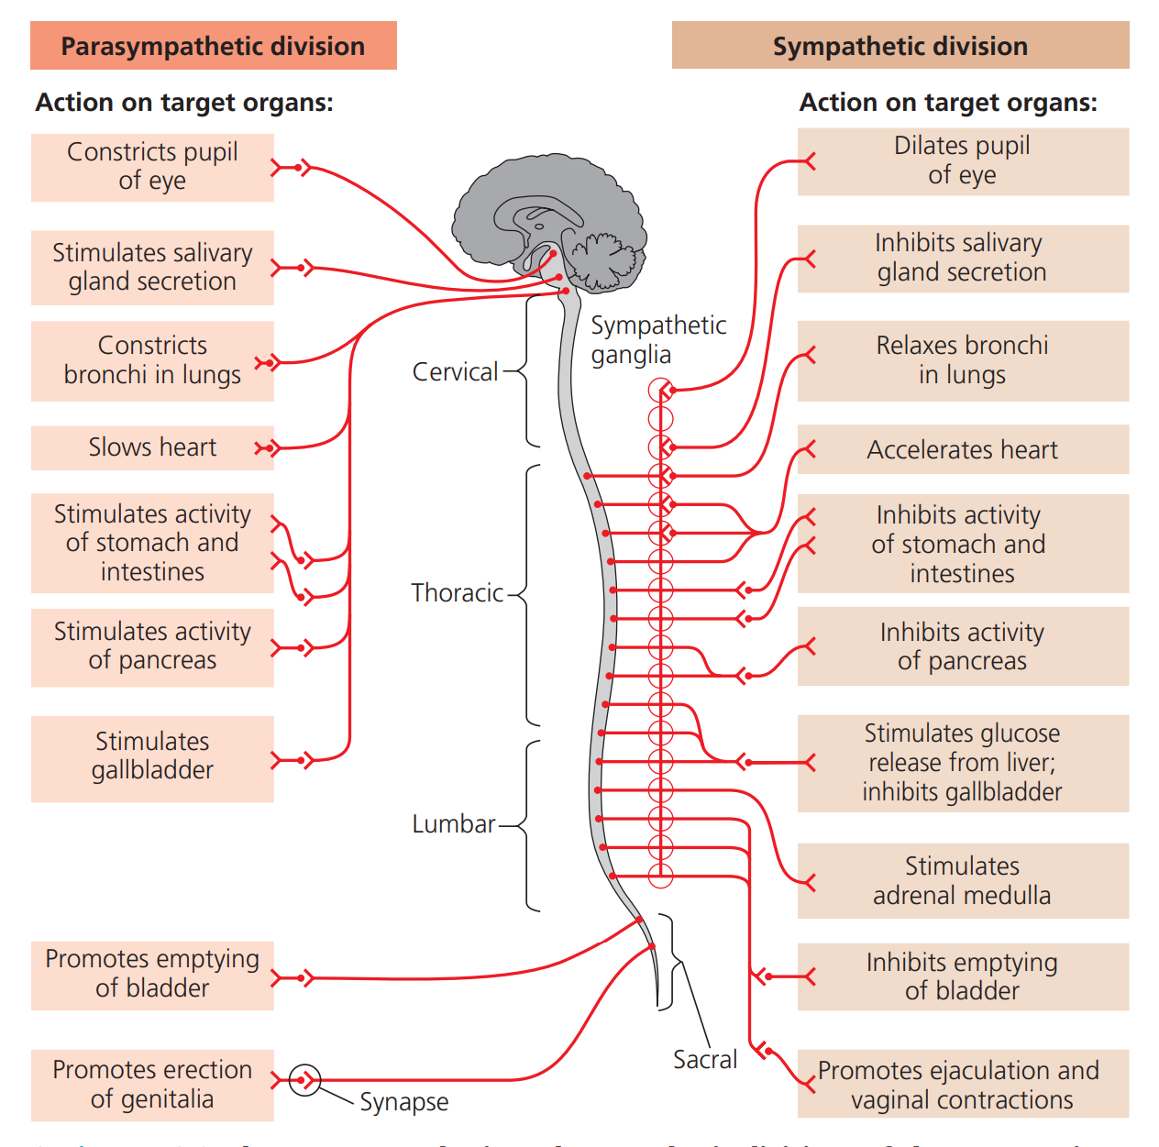
Pathways in each division consist of preganglionic neurons from CNS and postganglionic neurons (PNS)

Slide 20
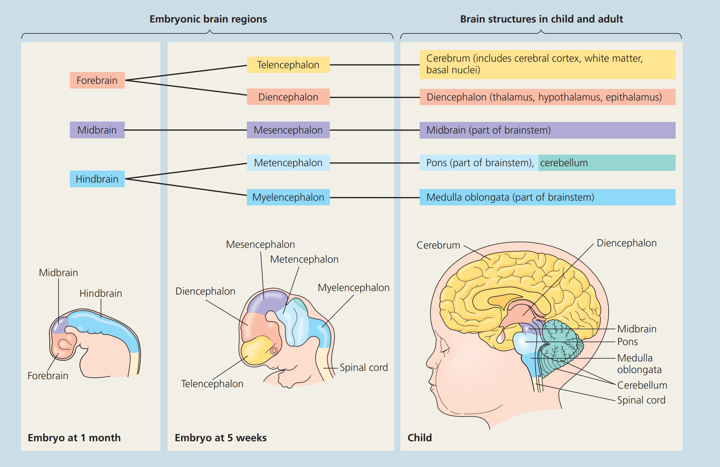
Developmental Stages

Slide 21
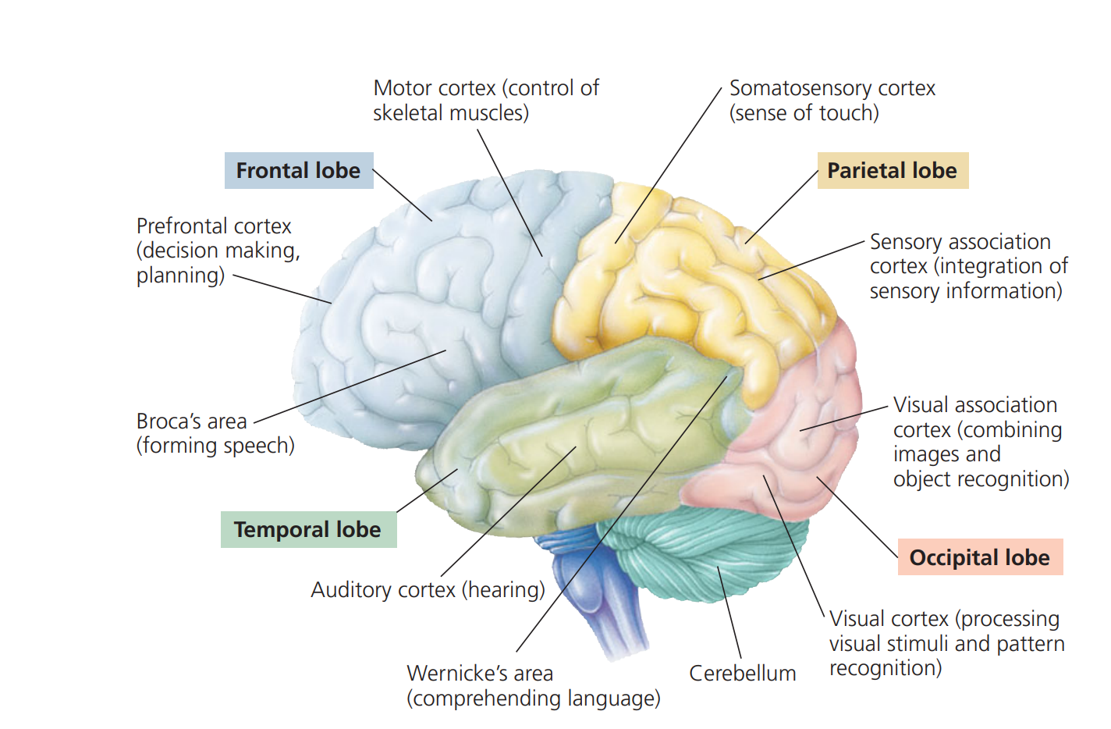

Slide 22
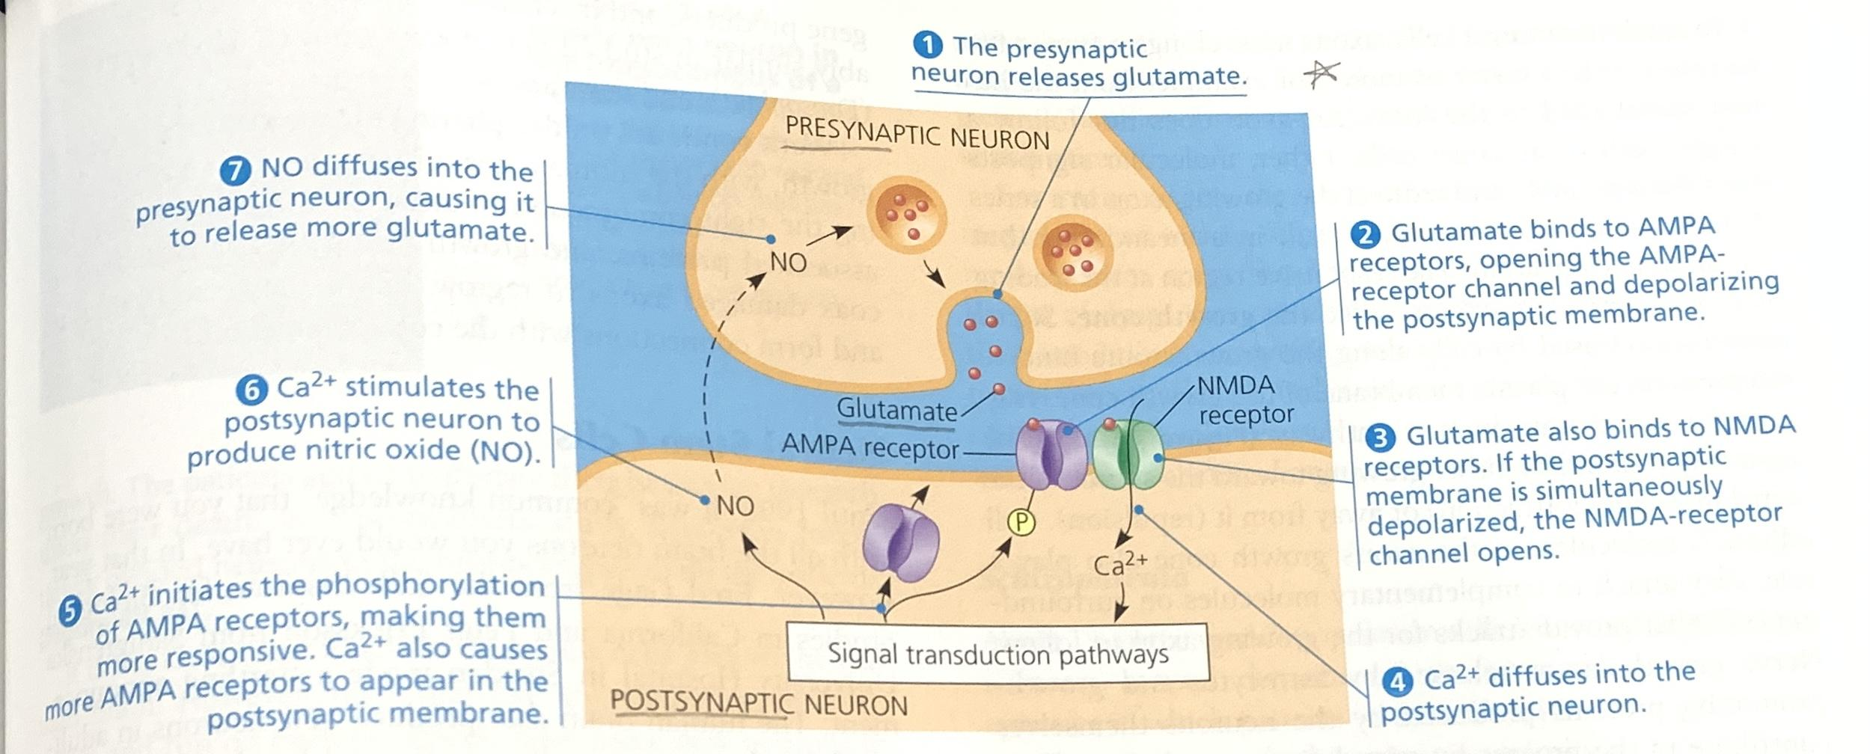
Long Term Potentiation
LTP: increase in strength of synaptic transmission when presynaptic neurons produce many action potentials at once; helps with memory storage & learning

Slide 23
Kahoot!
Notes:
Snowhyhare640

